Slide 1

Flight Delays-keeping travelers on time
Milestone 3.2
By Orpheas, Marco and Adam

Slide 2

The Problem we are trying to solve
Through this project we aim to solve a problem faced by thousands per day – FLIGHT DELAYS
This problem has affected all three of us and most definitely you to, therefore we would like to find a possible solution to aid in this issue
Flight delays may seem minor at first but if we look into a problem as such, the severity can be clearly seen
Flight delays lead to:
Passenger frustration – affect schedules (connecting flights, plans etc.) and causes inconvenience
Economic impact – cost to airlines, passengers and businesses
Uncertainty in travels plans - ruins a schedule, makes it difficult to plan

Slide 3
The Problem we are trying to solve
We hope to find any correlations through the data from the causes which will be able to give us answers and solutions to help aid in the minimization of global delays in airports and the cost that comes with it.
Our aim is to analyze historical flight data to identify patterns and predict the likelihood of a flight being delayed as well as the reasons for this delay.

Slide 4
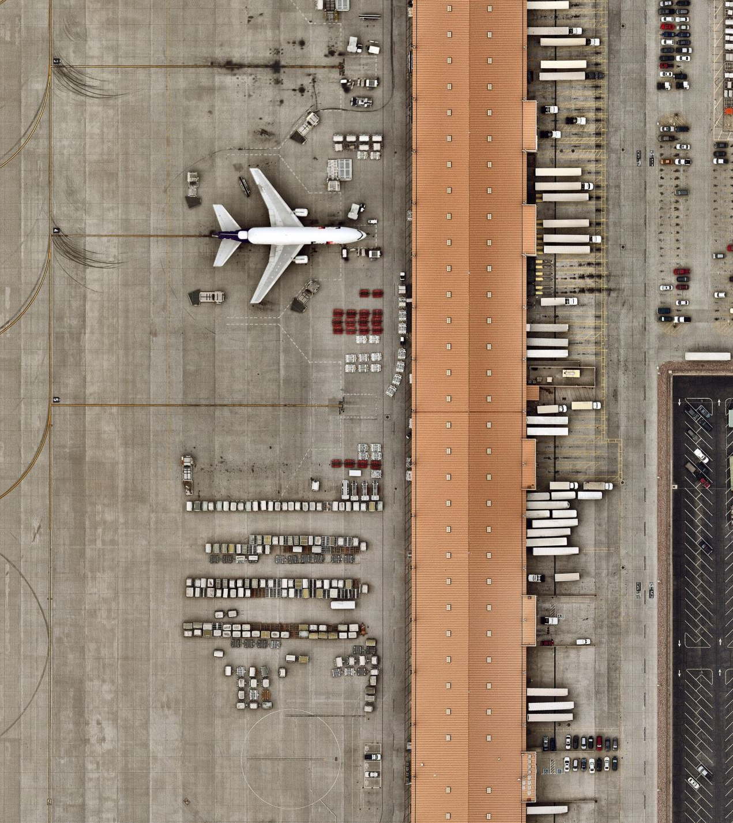
Our Data – Key Plots-What We Learnt
After importing, reading the data and checking for any missing values and duplicates we created bar plots of the busiest and least busy airports through their airport codes (“Origin”) and the number of flights that they had in the specific year of the data.
We made this plot to get a visualization of the airports with the highest activity which will come in handy later

Slide 5
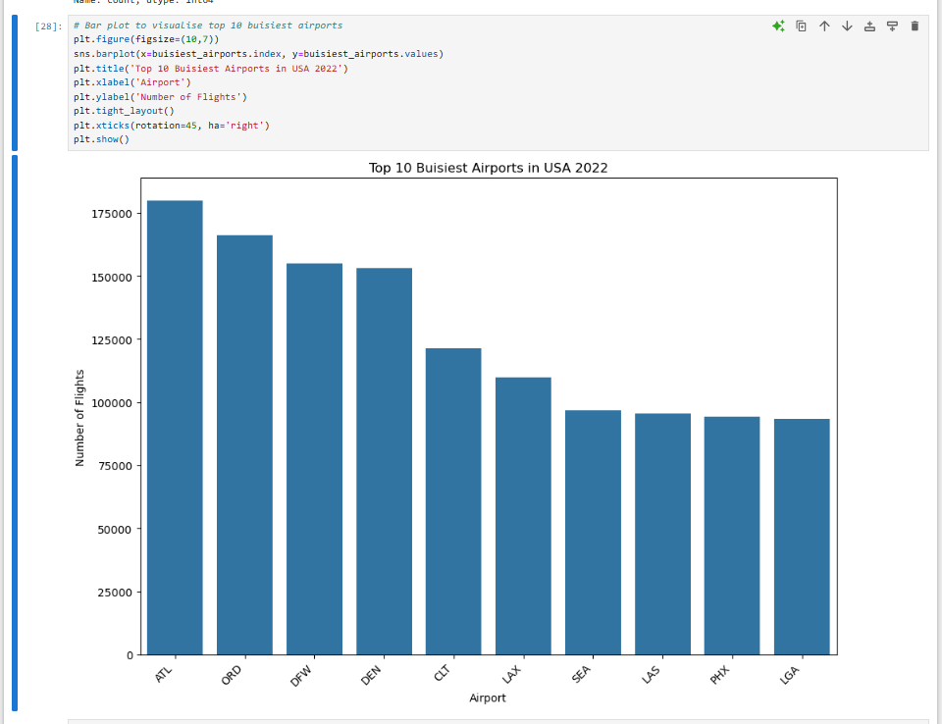
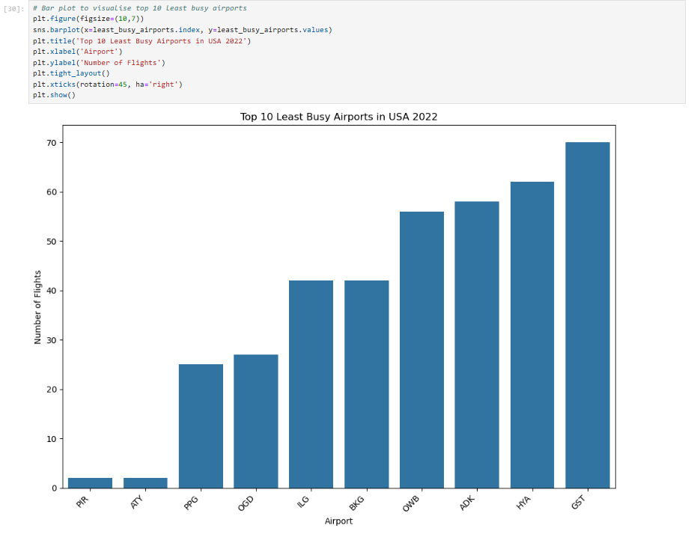

Slide 6
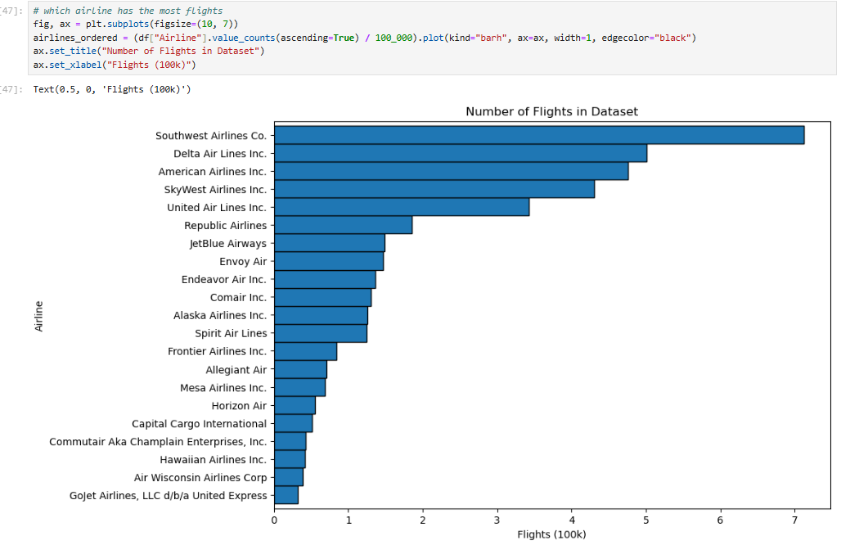
Our Data – Key Plots-What We Learnt
We also made of plot with the Airline and the number of flights they had which we could use later to see if there is any correlation with Airline and other factors
Southwest had to most flights

Slide 7
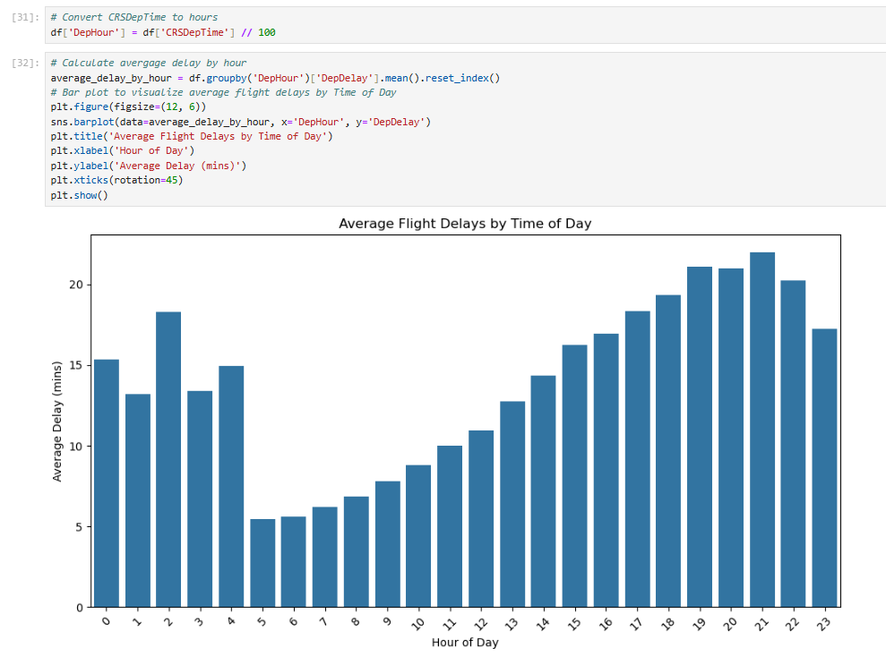
Our Data – Key Plots- What we Learnt
We made a bar plot to visualize the distribution of Average Flight Delays by time of day and saw that the times with the longest average flight delays where between 7pm-10pm with the longest being at 9pm.
Therefore, we concluded that at night is where the flight delays are longest.
We also saw that from around 5am the average time of delays gradually starts rising until the night.

Slide 8
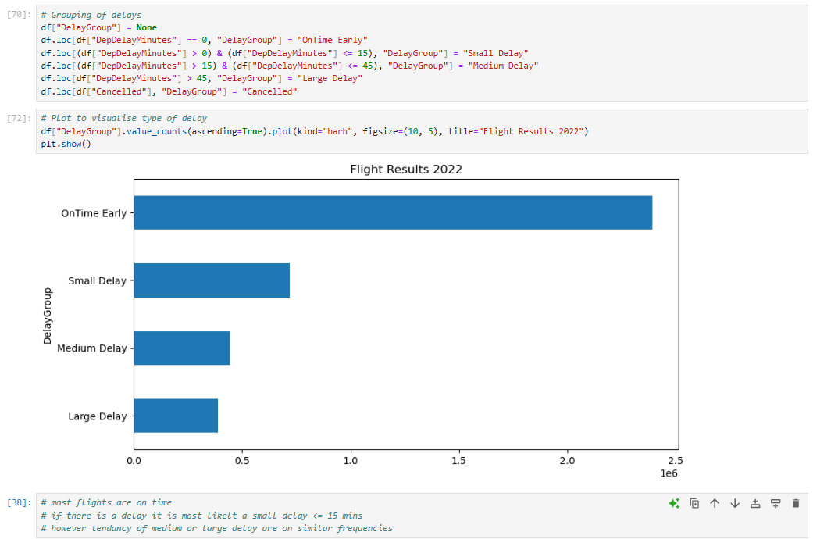
Our Data – Key Plots – What we Learnt
We split the “DepDelayMinutes” column in 4 sub columns ranging with magnitude of time delay :
OnTime Early – No delay
Small Delay – Delay <= 15 mins
Medium Delay – 15mins< Delay <= 45mins
Large Delay – Delay > 45mins
The plot showed that most flights have no delay but from the flights that have a delay “Small Delay” was the most common although with not a significant difference from the other two indicating that the probaility of each type of delay happening is similar – A great problem!

Slide 9
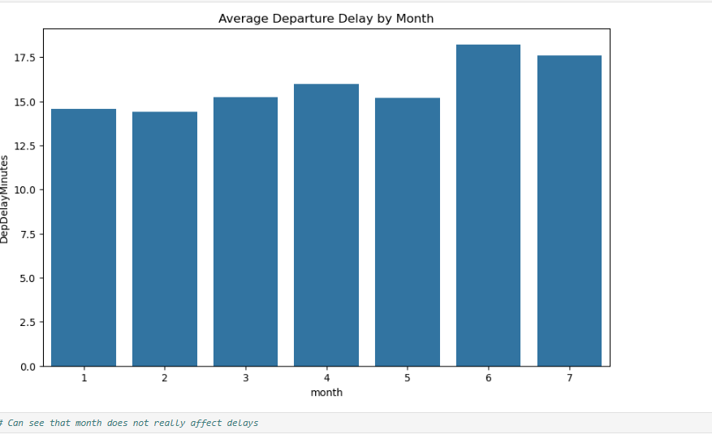
Our Data – Key Plots – What we Learnt
Bar plot for average departure delay by Month
This plot was unsuccessful as through the plot we realised that our data didn’t have flights on all the months of the year.
However, it somewhat showed that the month doesn’t affect delays by a significant effect

Slide 10
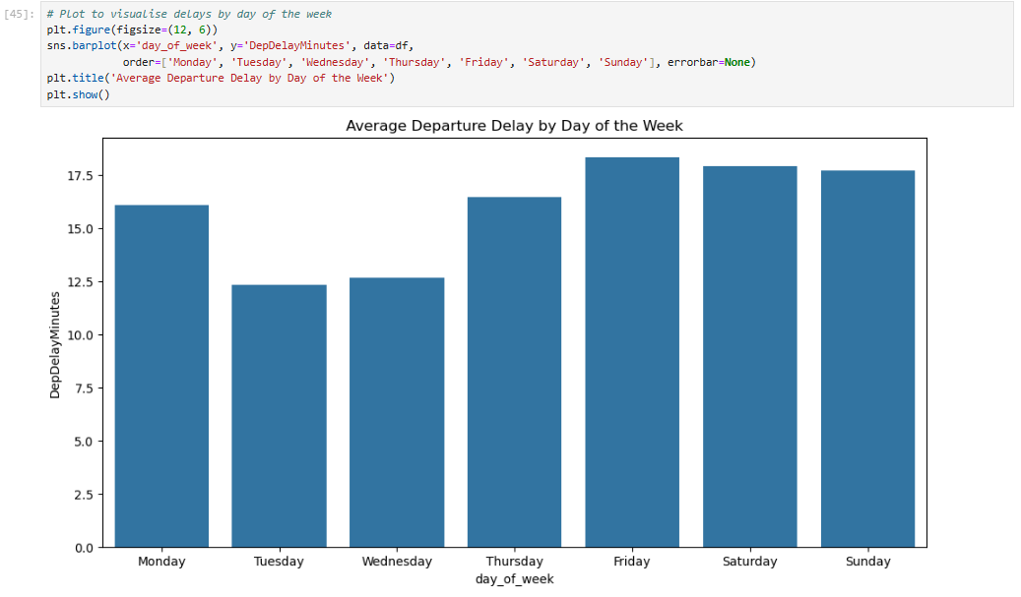
Our Data – Key Plots – What we Learnt
Since the months was unsuccessful, we split the data in days of the week.
The bar plot of showed that the weekend and Fridays had the longest delays on average we seems logical.
Friday had the longest delays and Tuesday the shortest.
Delay time rises from Tuesday until it reaches Friday and then starts to decrease again.

Slide 11
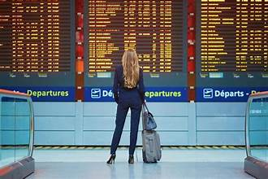
Our Data – Key Plots – What we Learnt
Since weekends and Fridays had the greatest time delays we decided to sort our data into the three specified days to further examine the data and come to conclusions
We split our data in “Weekend” – Fri, Sat, Sun and “Not Weekend”- All other days
We then made a similar bar plot like before of time of day and average delay to compare and see any other differences

Slide 12
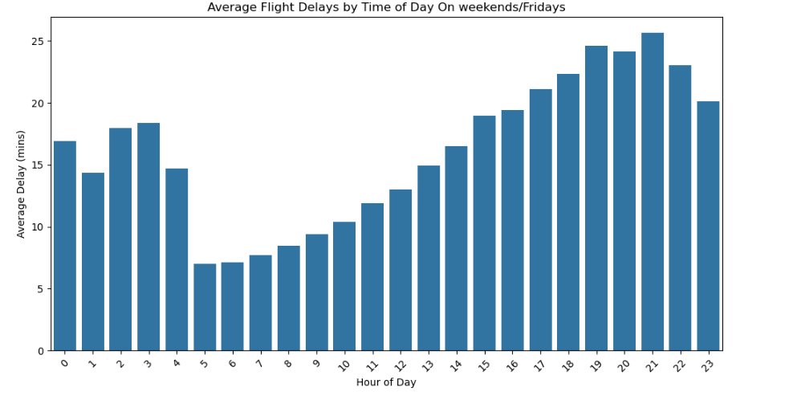
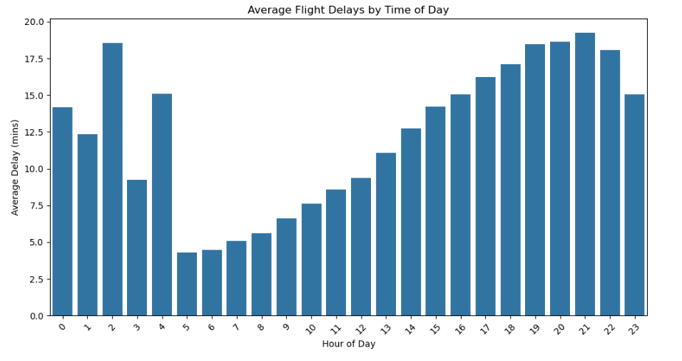
“Weekend” vs “Not Weekend”
Weekend
Not Weekend
Overall shape of two Bar charts looks the same however for weekend and Friday each time delay for the hour is of greater magnitude which was expected. Therefore, the day doesn’t affect the hour of delay that much

